Slide 1
TAK Server - Federations

Slide 2
TAK Server - Federations Intro
Federations allow subsets of TAK users who are connected to different servers to work together, even though each server may be run by independent organizations.
Each admin domain does not need to share anything about their internal structure with the other admin domains.
Each admin domain has control over what data they share with the other domains but has no control over what the other admin domains do with the data that is shared.
It requires no reconfiguration of TAK devices connected to either end and does not allow direct connections of TAK devices from the other admin domains.

Slide 3
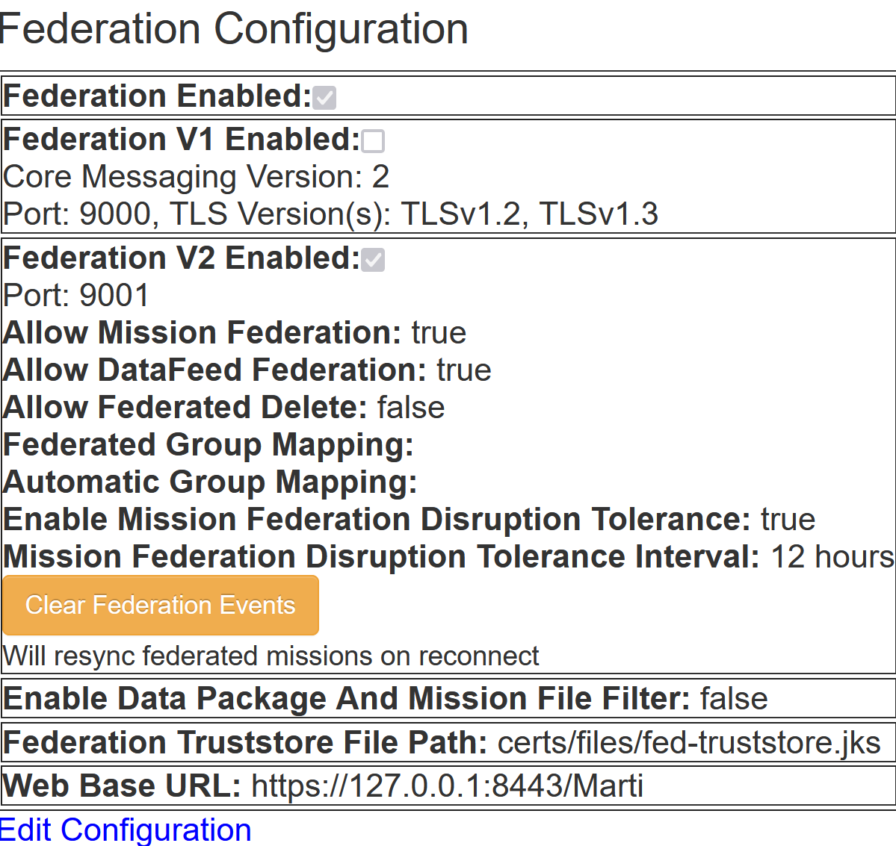
TAK Server - Federation Setup
Enable federation configuration:
On the admin dashboard:
Navigate to the following: hamburger menu → Configuration → Federation
Select “Edit Configuration”
Enable “Federation Enabled: “
Select “Save”
Make note of the port that the federation is using:
9001

Slide 4
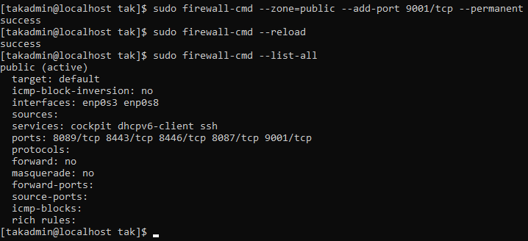
TAK Server - Federation Setup - Firewall
Within a terminal that is SSH’d into the server run the following:
List all the ports:
sudo firewall-cmd --list-all
If the port we are using for the federation is not listed, add it:
sudo firewall-cmd --zone=public --add-port 9001/tcp --permanent
Reload the firewall
sudo firewall-cmd --reload
Ensure the port update:
sudo firewall-cmd --list-all
Notes:
# We need to make sure the port that the federation is attempting to use is open and available or else we need to update the firewall settings.

Slide 5
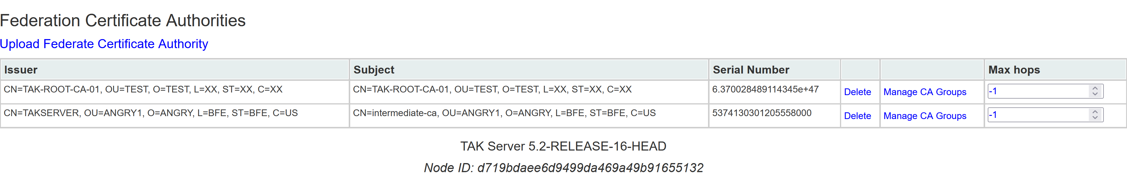
TAK Server - Federation Setup - Upload Federate Certificates
To connect federate servers, you need to exchange their public CA:
CA location:
cd /opt/tak/certs/files/ca.pem
Once the CAs have been exchanged you can go to the “Federate Certificate Authorities”:
Admin dashboard → hamburger menu → Configuration → Federate Certificate Authorities
Select “Upload Federate Certificate Authority”
Notes:
# In order for the federate servers to trust each other and their clients, they must share each others certificate authorities in order to create a separate federate trust-store. The connection is possible by having two trust stores, one for local users and one for federates.

Slide 6
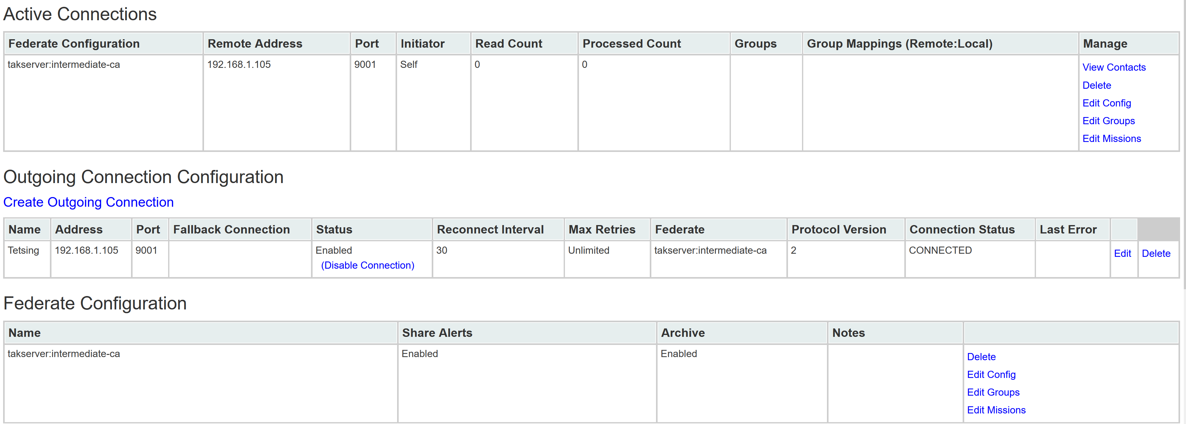
TAK Server - Federation Setup - Making the Connection
To make the connection, only one of the servers will create an outgoing connection to the other.
On the server that is starting the connection, go to the “Federation” section again.
To create the connection:
Select “Create Outgoing Connection”
Fill in the necessary information:
Display Name: <Your choice>
Address: <IP address of that server>
Port: 9001 (unless using a different one)
Select “Save”

Slide 7
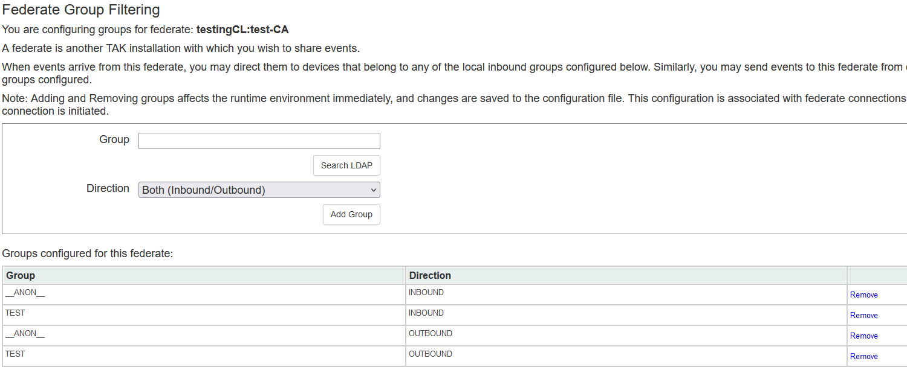
TAK Server - Federation Setup - Making the Connection
You will notice that no information is flowing between the federates, this is because both federates needs to specify which groups to allow to flow to the other server.
You can specify the group and the directions of information flowing between the servers.

Slide 8
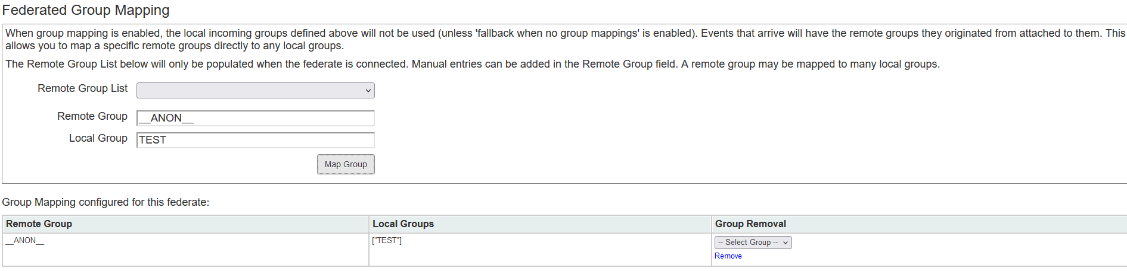
TAK Server - Federation Setup - Making the Connection
To manage the groups of the federate:
Select “Edit Groups” for the desired federate.
Federate Group Filtering:
If you have LDAP set-up you will be able to search for the group and add it.
Federate Group Mapping:
You can specify the incoming group and map it to your desired group.
Server1(sender): __ANON__ Server2(receiver): __ANON__ → TEST
You can have multiple group mappings to both multiple remote groups and multiple local groups.

Slide 9
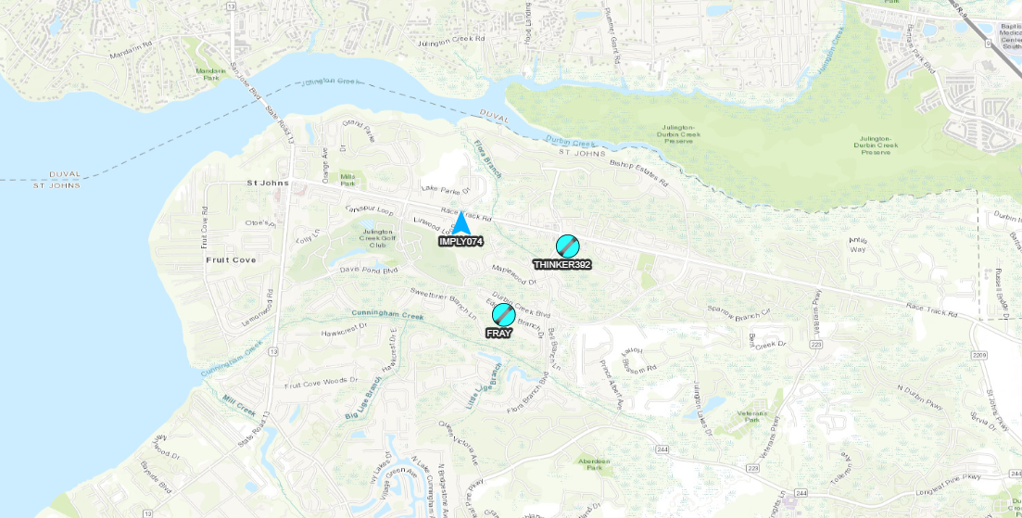
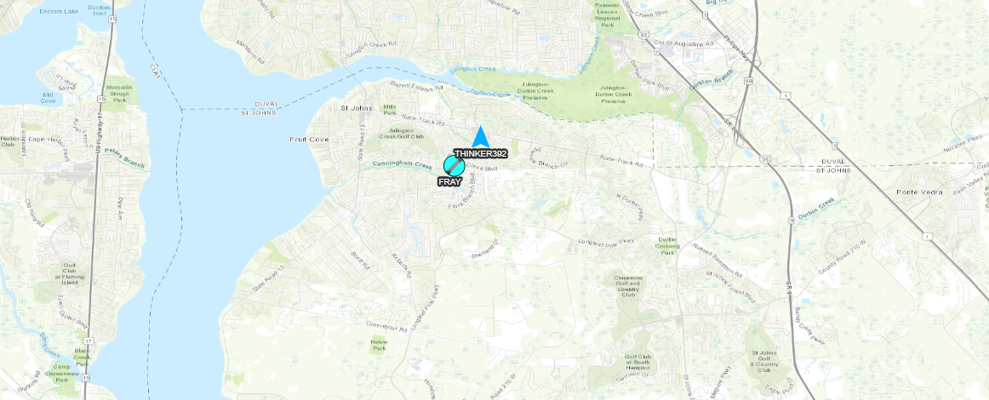
TAK Server - Federation Connection
Server 1: Making Connection
Server 2: Receiving Connection
Above you can see on the left that the server receiving the federate connection shows the other markers on the map. The right side is showing the other federated marker, along with other markers.

Slide 10
TAK Server - Mission Federation Disruption Tolerance
Within the “Federation” tab, when editing the federation configuration, there is a “Enable Mission Federation Disruption Tolerance” option.
The option will update each server with changes to federated missions that occurred during a disruption in the connection.
Below that you are able to limit the changes that are updated to the server to a predetermined length of time.
If the “Unlimited” option is selected, then all updates made between the disruption and the time of reconnecting will be loaded.
Be aware that without a limit there is a potential for an update to take a lot of bandwidth.
There is also a “Clear Federation Events” button that is available when done editing the configuration that will reset the disruption history for federations.

Slide 11
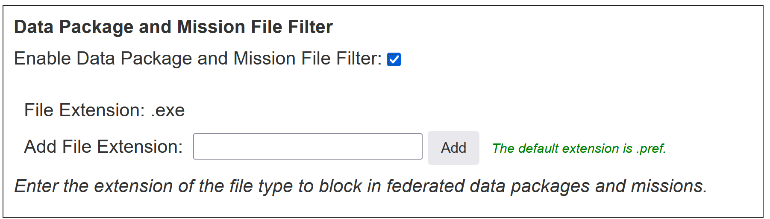
TAK Server - Data Package and Mission File Blocker
Data packages and mission packages can be federated between servers and their respective clients. These can lead to unwanted configuration changes to TAK devices.
Within the federation configuration you are able to set a filter to block files by their type.
To use this feature:
Enable the “Enable Data Packaged and Mission File Filter” option.
Enter the file type you wish to block within the “Add File Extension” box then selecting “Add”.
By default, the type is: .pref
You can change the type to of file that is blocked by adding a new.
Once done select “Save” at the bottom.

